Slide 1
Python with fractals
By: Tharun & Siti zulaiha

Slide 2
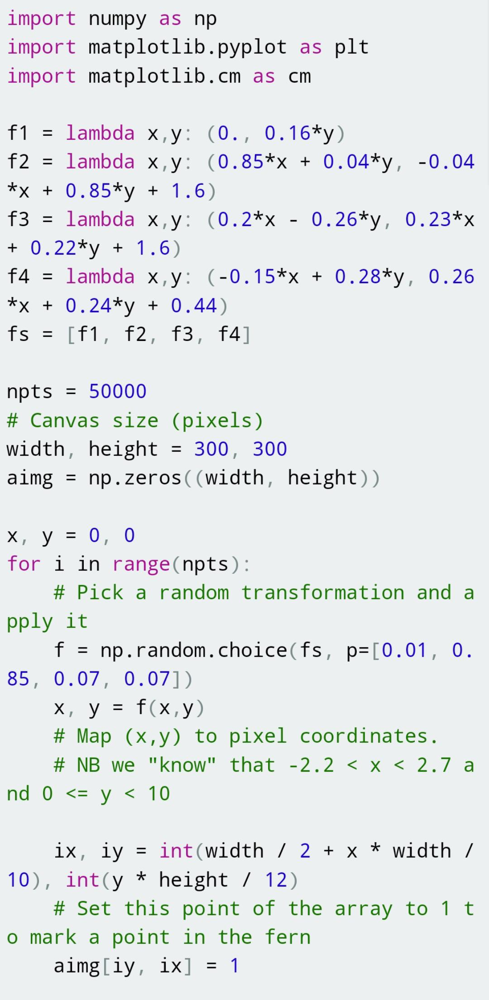
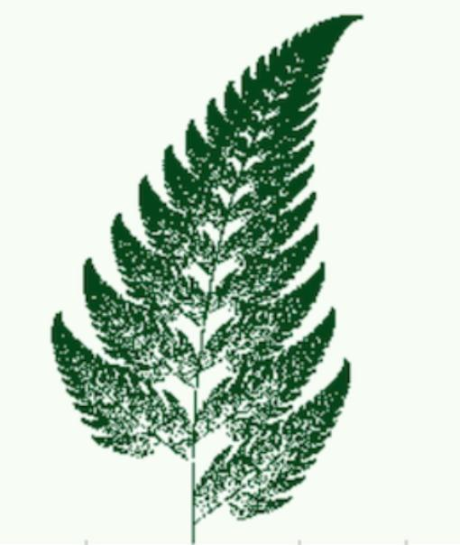
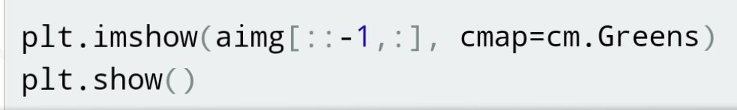
Barnsley Fern
Source: scipython.com

